Slide 1
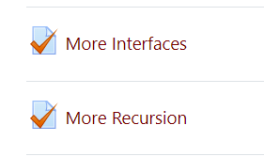
CSSE 220
More interfaces
The git projects for today are:
PracticeBettingInterfaces
PracticeBettingInterfacesSolution
PracticeRecursiveHelperFunctions
PracticeRecursiveHelperFunctionsSolution
Notes:
SPECIAL TA INSTRUCTIONS:
BE SURE TO WALK AROUND while students work on recursion examples and NUDGE in the right direction
INSTRUCTOR:
Be sure to start quiz BEFORE the break
Leave 15+ minutes at the end AFTER showing UML for the refactoring of the code

Slide 2
BettingInterfaces
If you can, work with a classmate (some have been arranged, others not yet)
Understand the given code, the duplication, plus the additional features you will be adding. Look at 3 TODOs in BettingMain.
Design a solution for all 3 TODOs using interfaces and make a UML diagram describing it
Compare your UML solution to the final solution BEFORE you start coding
I recommend you do each TODO one by one rather than doing everything in one go

Slide 3
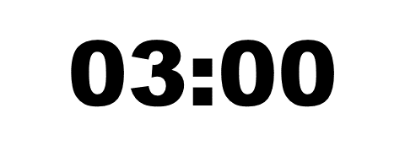
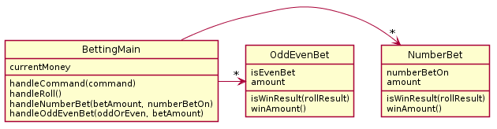
UML as it currently stands
What do you need to add?
What do the Bet classes have in common?
Notes:
Can ask students to draw this out themselves to make sure they can translate from code to UML and then show this to verify they understood what they needed to write.
@startuml
class BettingMain {
currentMoney
handleCommand(command)
handleRoll()
handleNumberBet(betAmount, numberBetOn)
handleOddEvenBet(oddOrEven, betAmount)
}
class NumberBet {
numberBetOn
amount
isWinResult(rollResult)
winAmount()
}
class OddEvenBet{
isEvenBet
amount
isWinResult(rollResult)
winAmount()
}
BettingMain -> "*" NumberBet
BettingMain -> "*" OddEvenBet
@enduml

Slide 4
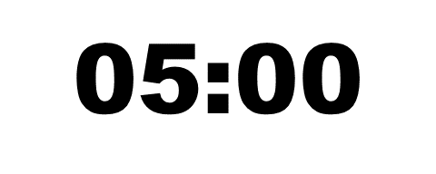
Hints
Your interface will likely be called Bet
You should have 3 classes implementing Bet, one for each of the current types of bets in the code, one for the new one you’re being asked to implement
You’ll need to update the lists in main to a single ArrayList<Bet> (or some other storage method to main)

Slide 5
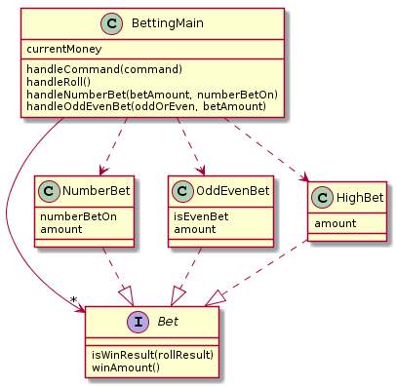
UML Of Refactored Solution
Notes:
@startuml
skinparam style strictuml
class BettingMain {
currentMoney
handleCommand(command)
handleRoll()
handleNumberBet(betAmount, numberBetOn)
handleOddEvenBet(oddOrEven, betAmount)
}
interface Bet {
isWinResult(rollResult)
winAmount()
}
class NumberBet {
numberBetOn
amount
}
class OddEvenBet{
isEvenBet
amount
}
class HighBet{
amount
}
BettingMain ->"*" Bet
BettingMain .-> HighBet
BettingMain .-> NumberBet
BettingMain .-> OddEvenBet
HighBet .-|> Bet
NumberBet .-|> Bet
OddEvenBet .-|> Bet
@enduml

Slide 6
Step 1 for refactoring
Identify the operations in the .java files that are candidates for moving to the Interface

Slide 7
Steps 2, 3, and 4 for refactoring

Slide 8
Steps 5, 6, and 7 for refactoring

Slide 9
Eclipse auto-modifies open file

Slide 10
Eclipse auto-modifies the project

Slide 11
Now you complete the refactoring

Slide 12
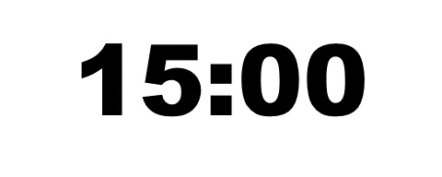
UML Of Refactored Solution
Extract Interface
Implement Interface
Combine lists into one
Test to verify it works
Add HighBet class
Test to verify it works
Notes:
@startuml
skinparam style strictuml
class BettingMain {
currentMoney
handleCommand(command)
handleRoll()
handleNumberBet(betAmount, numberBetOn)
handleOddEvenBet(oddOrEven, betAmount)
}
interface Bet {
isWinResult(rollResult)
winAmount()
}
class NumberBet {
numberBetOn
amount
}
class OddEvenBet{
isEvenBet
amount
}
class HighBet{
amount
}
BettingMain ->"*" Bet
BettingMain .-> HighBet
BettingMain .-> NumberBet
BettingMain .-> OddEvenBet
HighBet .-|> Bet
NumberBet .-|> Bet
OddEvenBet .-|> Bet
@enduml

